Slide 1
4. Backpropagation
4.1 Multilayer feedforward networks
4.2 Backpropagation algorithm
4.3 Working with backpropagation
4.4 Advanced algorithms
4.5 Performance of multilayer perceptrons
4.6 MATLAB Live Script examples

Slide 2
Motivation
Single-layer networks have severe restrictions
Only linearly separable tasks can be solved
Minsky and Papert (1969)
Showed a power of a two-layer feed-forward network
But didn’t find the solution on how to train the network
Werbos (1974)
Parker (1985), Cun (1985), Rumelhart (1986)
Solved the problem of training multi-layer networks by back-propagating the output errors through hidden layers of the network
Backpropagation learning rule

Slide 3
4.1 Multilayer feedforward networks
Important class of neural networks
Input layer (only distributing inputs, without processing)
One or more hidden layers
Output layer
Commonly referred to as multilayer perceptron

Slide 4
Properties of multilayer perceptrons
Neurons include nonlinear activation function
Without nonlinearity, the capacity of the network is reduced to that of a single layer perceptron
Nonlinearity must be smooth (differentiable everywhere), not hard-limiting as in the original perceptron
Often, a logistic function is used:
One or more layers of hidden neurons
Enable learning of complex tasks by extracting features from the input patterns
Massive connectivity
Neurons in successive layers are fully interconnected

Slide 5
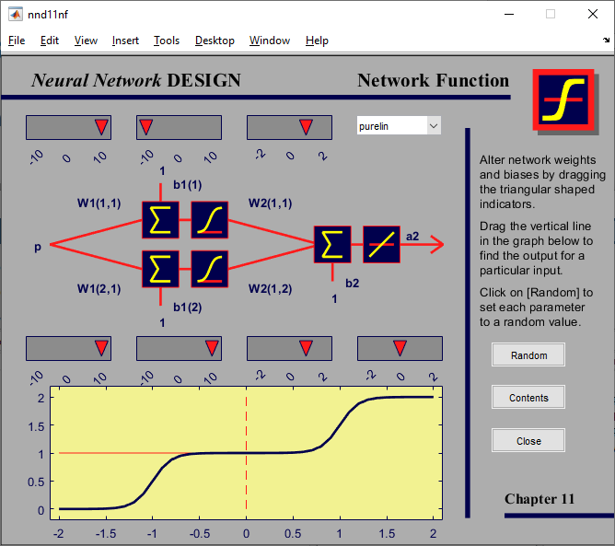
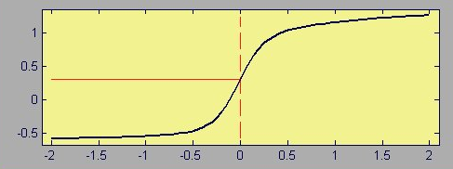
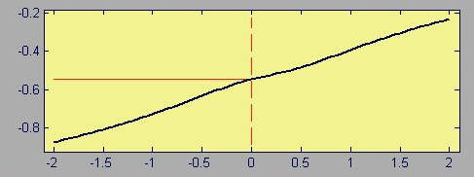
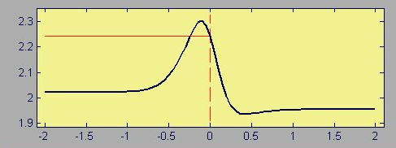
MATLAB demo
Run built-in command in MATLAB:
>> nnd11nf % Response of the feedforward network with one hidden layer

Slide 6
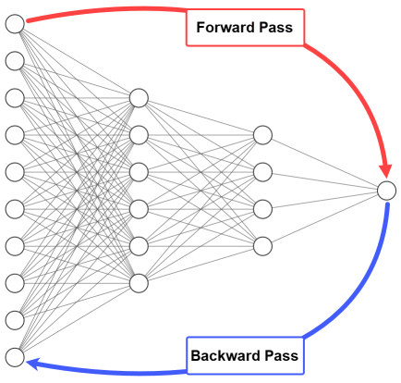
About backpropagation
Multilayer perceptrons can be trained by the backpropagation learning rule
Based on the error-correction learning rule
Generalization of LMS learning rule (used to train ADALINE)
Backpropagation consists of two passes through the network
Forward pass
Input is applied to the network
Input is propagated to the output
Synaptic weights stay frozen
Error signal is calculated
Backward pass
Error signal is propagated backward
Error gradients are calculated
Synaptic weights are adjusted
Notes:
Image source: https://neptune.ai/blog/backpropagation-algorithm-in-neural-networks-guide

Slide 7
4.2 Backpropagation algorithm (1/9)
A set of learning samples (inputs and target outputs)
Error signal at output layer, neuron j, learning iteration n
Instantaneous error energy of output layer with R neurons
Average error energy over all learning set
Notes:
Haykin p.161

Slide 8
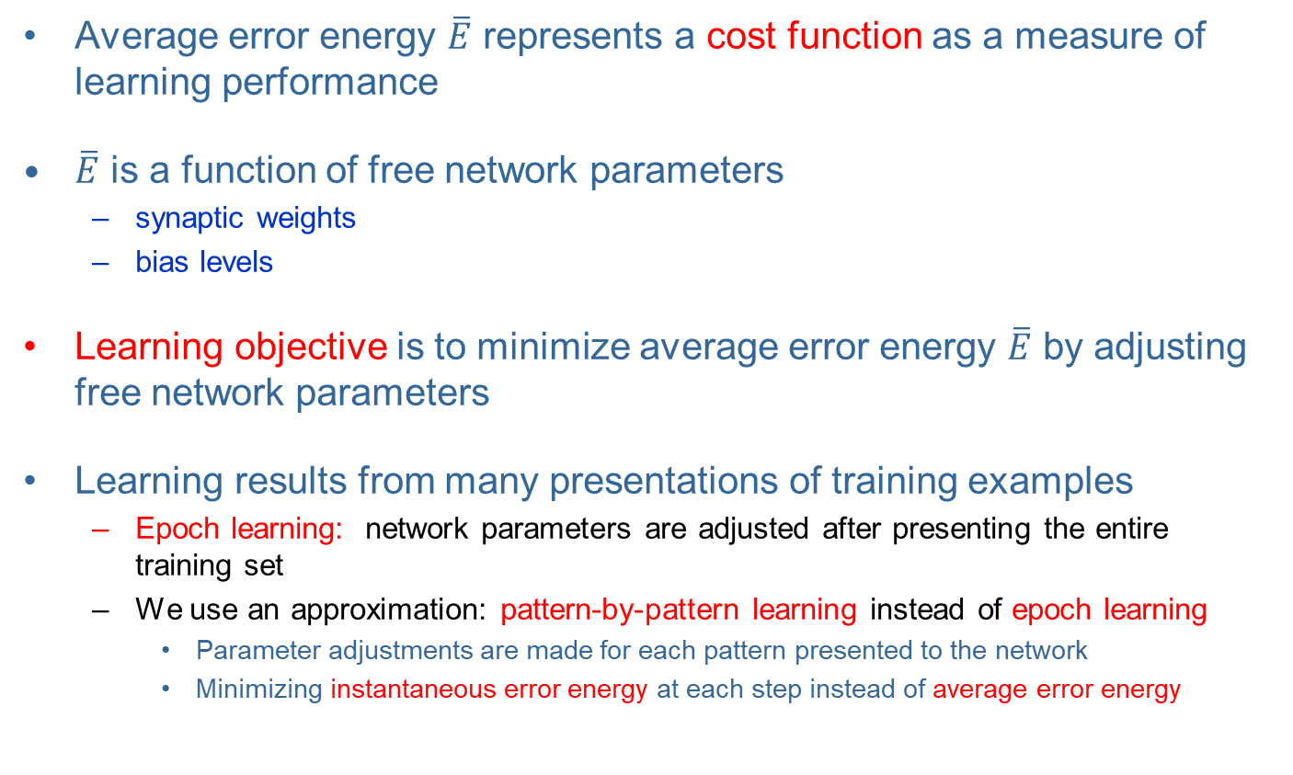
Backpropagation algorithm (2/9)
Average error energy $\overline{E}$ represents a cost function as a measure of learning performance
$\overline{E}$ is a function of free network parameters
synaptic weights
bias levels
Learning objective is to minimize average error energy $\overline{E}$ by adjusting free network parameters
Learning results from many presentations of training examples
Epoch learning: network parameters are adjusted after presenting the entire training set
We use an approximation: pattern-by-pattern learning instead of epoch learning
Parameter adjustments are made for each pattern presented to the network
Minimizing instantaneous error energy at each step instead of average error energy

Slide 9
Backpropagation algorithm (3/9)
Similar to the LMS algorithm, backpropagation applies correction of weights proportional to the partial derivative
Expressing this gradient by the chain rule
Instantaneous error energy
output error
network output
induced local field
synaptic weight

Slide 10
Backpropagation algorithm (4/9)
Gradient on output error
Gradient on network output
Gradient on induced local field
Gradient on synaptic weight

Slide 11
Backpropagation algorithm (5/9)
Putting gradients together
Correction of synaptic weight is defined by the delta rule
Learning rate
Local gradient
Notes:
Learning rate: eta (η)

Slide 12
Backpropagation algorithm (6/9)
CASE 1 Neuron j is an output node
Output error e_{j}(n) is available
Computation of local gradient is straightforward
CASE 2 Neuron j is a hidden node
Hidden error is not available → Credit assignment problem
Local gradient solved by backpropagating errors through the network
How to calculate the derivative of output error energy E on hidden layer output y_{j} ?
Notes:
The green text is the invitation to the next slide.

Slide 13
Backpropagation algorithm (7/9)
CASE 2 Neuron j is a hidden node ...
Instantaneous error energy of the output layer with R neurons
Expressing the gradient of output error energy E on hidden layer output y_{j}

Slide 14
Backpropagation algorithm (8/9)
CASE 2 Neuron j is a hidden node ...
Finally, combining ansatz for hidden layer local gradient
and gradient of output error energy on hidden layer output
gives final result for hidden layer local gradient

Slide 15
Backpropagation algorithm (9/9)
Backpropagation summary
Local gradient of an output node
Local gradient of a hidden node
Weight Learning Local Input of correction rate gradient neuron j

Slide 16
Two passes of computation
Forward pass
Input is applied to the network and propagated to the output
Inputs → Hidden layer output → Output layer output → Output error
→ → →
Backward pass
Recursive computing of local gradients
Output local gradients → Hidden layer local gradients
→
Synaptic weights are adjusted according to local gradients

Slide 17
Summary of the backpropagation algorithm
Initialization
Pick weights and biases from the uniform distribution with zero mean and variance that induces local fields between the linear and saturated parts of the logistic function
Presentation of training samples
For each sample from the epoch, perform forward pass and backward pass
Forward pass
Propagate training sample from network input to the output
Calculate the error signal
Backward pass
Recursive computation of local gradients from output layer toward input layer
Adaptation of synaptic weights according to generalized delta rule
Iteration
Iterate steps 2-4 until the stopping criterion is met
Notes:
Run the MATLAB demo on the next slide for a practical demonstration of backpropagation calculation.

Slide 18
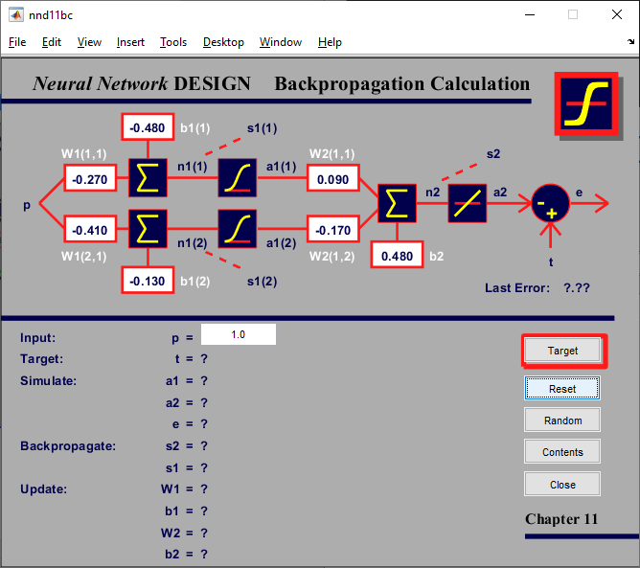
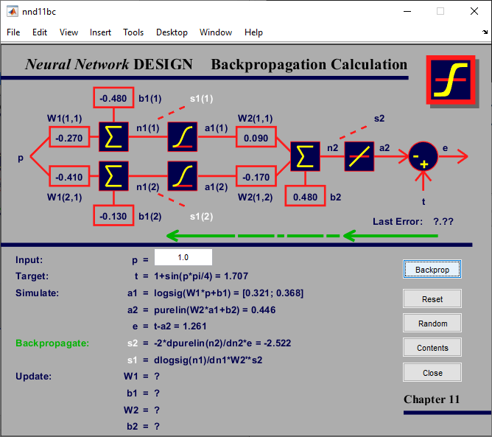
MATLAB demo
Run built-in command in MATLAB:
>> nnd11bc % Backpropagation calculation

Slide 19
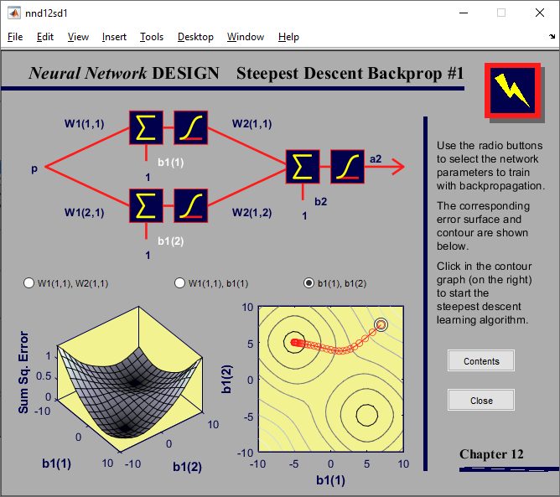
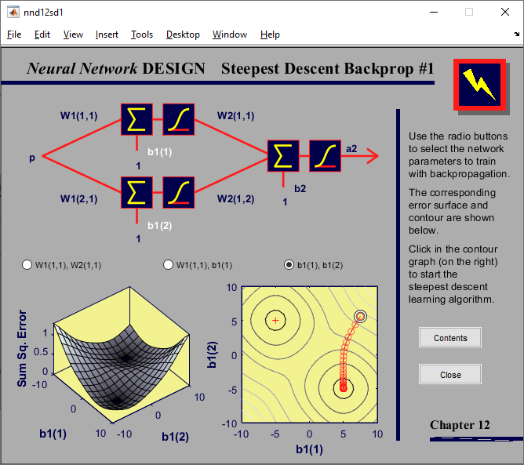
MATLAB demo
Run built-in command in MATLAB:
>> nnd12sd1 % Steepest descent

Slide 20
Backpropagation for ADALINE
Using backpropagation learning for ADALINE
No hidden layers, one output neuron
Linear activation function
Backpropagation rule
Original delta rule
Backpropagation is a generalization of a delta rule

Slide 21
4.3 Working with backpropagation
Efficient application of backpropagation requires some “fine-tuning”
Various parameters, functions, and methods should be selected
Training mode (sequential / batch)
Activation function
Learning rate
Momentum
Stopping criterium
Heuristics for efficient backpropagation
Methods for improving generalization

Slide 22
Sequential vs. batch training
Learning results from many presentations of training examples
Epoch = presentation of the entire training set
Batch training
Weight updating after the presentation of a complete epoch
Training is more accurate but very slow
Sequential training
Weight updating after the presentation of each training example
Stochastic nature of learning, faster convergence
Important practical reasons for sequential learning:
The algorithm is easy to implement
Provides an effective solution to large and difficult problems
Therefore sequential training is the preferred training mode
A good practice is random order of presentation of training examples

Slide 23
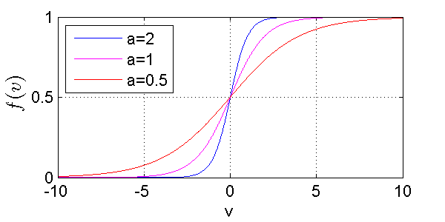
Activation function
Derivative of activation function is required for computation of local gradients
The only requirement for activation function: differentiability
Commonly used: logistic function
Derivative of the logistic function
Local gradient can be calculated without explicit knowledge of the activation function

Slide 24
Other activation functions
Using sin() activation functions
Equivalent to traditional Fourier analysis
Network with sin() activation functions can be trained by backpropagation
Example: Approximating a periodic function by
8 sigmoid hidden neurons 4 sin hidden neurons

Slide 25
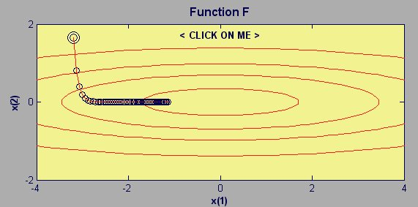

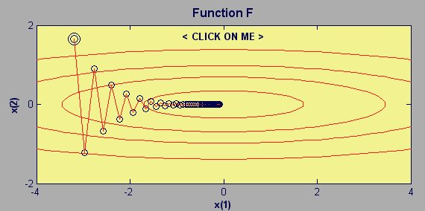

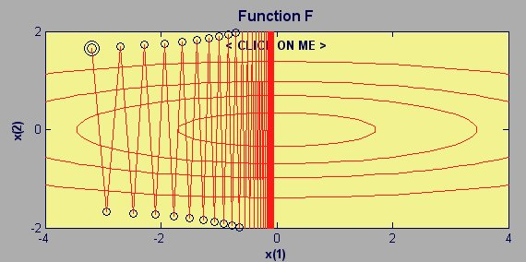

Learning rate
Learning procedure requires
Change in the weight space to be proportional to error gradient
True gradient descent requires infinitesimal steps
Learning in practice
Factor of proportionality is learning rate η →
Choose a learning rate as large as possible without leading to oscillations
Notes:
nnd9sdq

Slide 26
Stopping criteria
Generally, backpropagation cannot be shown to converge
No well-defined criteria for stopping its operation
Possible stopping criteria
Gradient vector
Euclidean norm of the gradient vector reaches a sufficiently small gradient
Output error
Output error is small enough
Rate of change in the average squared error per epoch is sufficiently small
Generalization performance
Generalization performance has peaked or is adequate
Max number of iterations
We are out of time ...

Slide 27
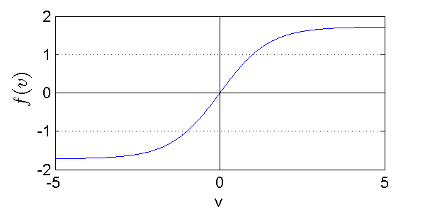
Heuristics for efficient backpropagation (1/3)
Maximizing information content
General rule: every training example presented to the backpropagation algorithm should be chosen on the basis that its information content is the largest possible for the task at hand
Simple technique: randomize the order in which examples are presented from one epoch to the next
Activation function
Faster learning with antisimetric sigmoid activation functions
Popular choice is:

Slide 28
Heuristics for efficient backpropagation (2/3)
Target values
Must be in the range of the activation function
Offset is recommended, otherwise learning is driven into saturation
Example: max(target) = 0.9 max(f)
Preprocessing inputs
Normalizing mean to zero
Decorrelating input variables (by using principal component analysis)
Scaling input variables (variances should be approx. equal)
Original a) Zero mean b) Decorrelated c) Equalized variance

Slide 29
Heuristics for efficient backpropagation (3/3)
Initialization
Choice of initial weights is important for a successful network design
Large initial values → saturation
Small initial values → slow learning due to operation only in the saddle point near origin
Good choice lies between these extreme values
Standard deviation of induced local fields should lie between the linear and saturated parts of its sigmoid function
tanh activation function example (a=1.72, b=0.67): synaptic weights should be chosen from a uniform distribution with zero mean and standard deviation
Learning from hints
Prior information about the unknown mapping can be included in the learning process
Initialization
Possible invariance properties, symmetries, ...
Choice of activation functions
m ... number of synaptic weights

Slide 30
Generalization
Neural network is able to generalize:
If input-output mapping computed by the network is correct for test data
Test data were not used during training
Test data are from the same population as training data
If correct network response is given for inputs that are slightly different than the training examples
Overfitting Good generalization

Slide 31
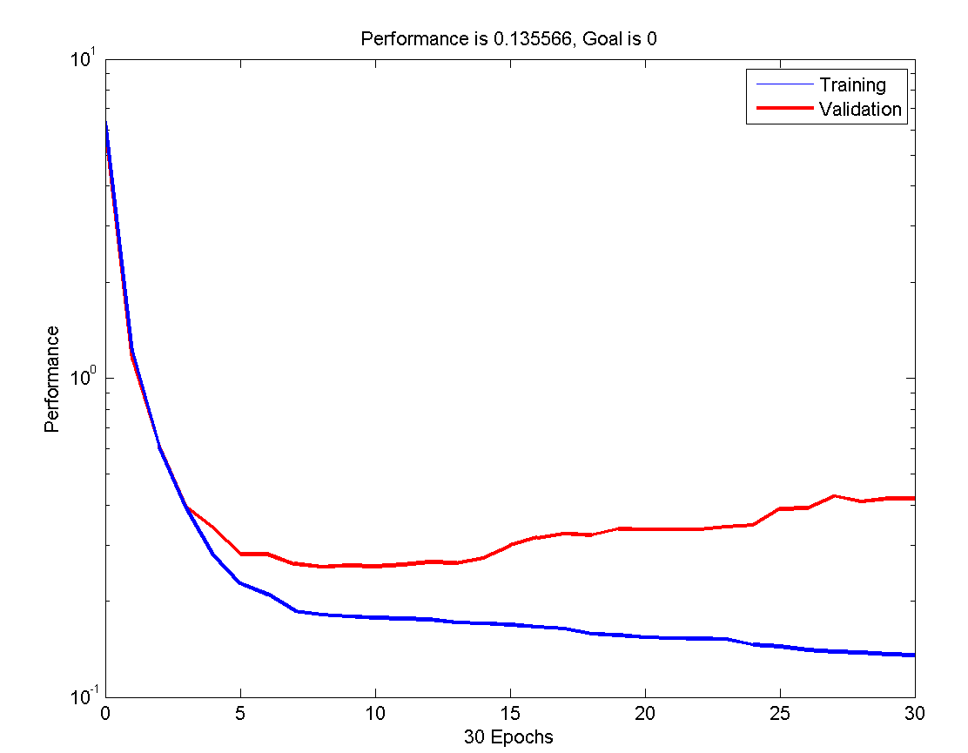
Improving generalization
Methods to improve generalization
Keeping the network small
Early stopping
Regularization
Early stopping
Available data are divided into three sets:
Training set – used to train the network
Validation set – used for early stopping, when the error starts to increase
Test set – used for final estimation of network performance and comparison of various models
Early stopping

Slide 32
Regularization
Improving generalization by regularization
Modifying performance function
with the mean sum of squares of network weights and biases
thus obtaining a new performance function
Using this performance function, the network will have smaller weights and biases, and this forces the network response to be smoother and less likely to overfit

Slide 33
Limitations of backpropagation
Some properties of backpropagation do not guarantee the algorithm to be universally useful:
Long training process
Possibly due to the non-optimum learning rate (advanced algorithms address this problem)
Network paralysis
Combination of sigmoidal activation and very large weights can decrease gradients almost to zero (vanishing gradient problem) → training is almost stopped
Local minima
Error surface of a complex network can be very complex, with many hills and valleys
Gradient methods can get trapped in local minima
Solutions: probabilistic learning methods (simulated annealing, ...)
Notes:
See also: https://en.wikipedia.org/wiki/Vanishing_gradient_problem

Slide 34
4.4 Advanced algorithms
Basic backpropagation is slow
Adjusts the weights in the steepest descent direction (negative of the gradient) in which the performance function is decreasing most rapidly
It turns out that, although the function decreases most rapidly along with the negative of the gradient, this does not necessarily produce the fastest convergence
Advanced algorithms based on heuristics
Developed from an analysis of the performance of the standard steepest descent algorithm
Momentum technique
Variable learning rate backpropagation
Resilient backpropagation
Numerical optimization techniques
Application of standard numerical optimization techniques to network training
Quasi-Newton algorithms
Conjugate Gradient algorithms
Levenberg-Marquardt algorithm

Slide 35
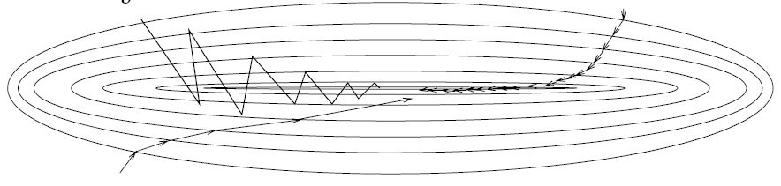
Momentum
A simple method of increasing learning rate yet avoiding the danger of instability
Modified delta rule by adding momentum term
Momentum constant
Accelerates backpropagation in steady downhill directions
Large learning rate
(oscillations)
Small learning rate
Learning with momentum

Slide 36
Variable learning rate η(t)
Another method of manipulating learning rate and momentum to accelerate backpropagation
Possible parameter values:
after weight update
if error decreases
If error increases less than ζ
If error increases more than ζ
weight update is accepted
learning rate is increased η(t+1) = ση(t), σ >1
if momentum has been previously reset to 0, it is set to its original value
weight update is accepted
learning rate is not changed η(t+1) = η(t),
if momentum has been previously reset to 0, it is set to its original value
weight update is discarded
learning rate is decreased η(t+1) = ρη(t), 0<ρ<1
momentum is reset to 0
Notes:
zeta, rho, eta, sigma

Slide 37
Resilient backpropagation
Slope of sigmoid functions approaches zero as the input gets large
This causes a problem when you use the steepest descent to train a network
Gradient can have a very small magnitude → also changes in weights are small, even though the weights are far from their optimal values
Resilient backpropagation
Eliminates these harmful effects of the magnitudes of the partial derivatives
Only sign of the derivative is used to determine the direction of weight update, the size of the weight change is determined by a separate update value
Resilient backpropagation rules:
Update value for each weight and bias is increased by a factor δ_{inc} if the derivative of the performance function concerning that weight has the same sign for two successive iterations
Update value is decreased by a factor δ_{dec} if the derivative concerning that weight changes sign from the previous iteration
If the derivative is zero, then the update value remains the same
If weights are oscillating, the weight change is reduced

Slide 38
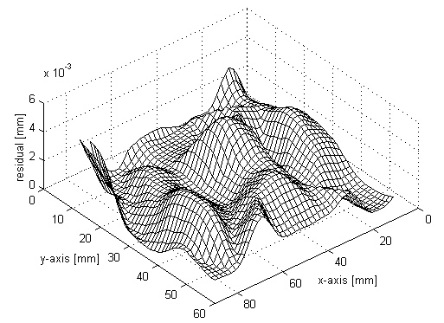
Numerical optimization (1/3)
Supervised learning as an optimization problem
Error surface of a multilayer perceptron, expressed by instantaneous error energy E(n), is a highly nonlinear function of synaptic weight vector w(n)
E(w₁,w₂)
w₂
w₁

Slide 39
Numerical optimization (2/3)
Expanding the error energy by a Taylor series
Local gradient
Hessian matrix

Slide 40
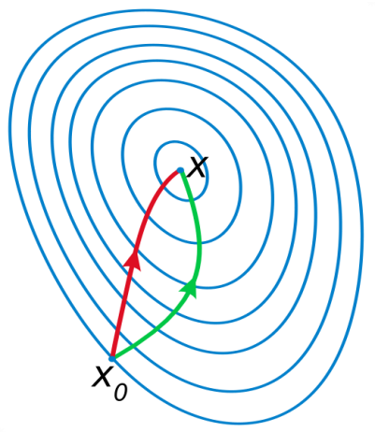
Numerical optimization (3/3)
Steepest descent method (backpropagation)
Weight adjustment proportional to the gradient
Simple implementation, but slow convergence
Significant improvement by using higher-order information
Adding momentum term → a crude approximation to use second-order information about error surface
Quadratic approximation about error surface → The essence of Newton’s method
H⁻¹ is the inverse of the Hessian matrix
gradient descent
Newton’s method
Notes:
http://en.wikipedia.org/wiki/Newton's_method_in_optimization
http://en.wikipedia.org/wiki/Newton's_method

Slide 41
Quasi-Newton algorithms
Problems with the calculation of the Hessian matrix
Inverse Hessian H⁻¹ is required, which is computationally expensive
Hessian has to be nonsingular which is not guaranteed
Hessian for a neural network can be rank deficient
No convergence guarantee for non-quadratic error surface
Quasi-Newton method
Only requires a calculation of the gradient vector g(n)
The method estimates the inverse Hessian directly without matrix inversion
Quasi-Newton variants:
Davidon-Fletcher-Powell algorithm
Broyden-Fletcher-Goldfarb-Shanno algorithm ... best form of Quasi-Newton algorithm!
Application for neural networks
The method is fast for small neural networks

Slide 42
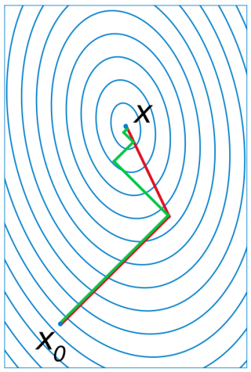
Conjugate gradient algorithms
Conjugate gradient algorithms
Second-order methods, avoid computational problems with the inverse Hessian
Search is performed along the conjugate directions, which produces generally faster convergence than steepest descent directions
In most of the conjugate gradient algorithms, the step size is adjusted at each iteration
A search is made along the conjugate gradient direction to determine the step size that minimizes the performance function along that line
Many variants of conjugate gradient algorithms
Fletcher-Reeves Update
Polak-Ribiére Update
Powell-Beale Restarts
Scaled Conjugate Gradient
Application for neural networks
Perhaps the only method suitable for large-scale problems (hundreds or thousands of adjustable parameters) → well suited for multilayer perceptrons
gradient descent
conjugate gradient

Slide 43
Levenberg-Marquardt algorithm
Levenberg-Marquardt algorithm (LM)
Similar to quasi-Newton methods, LM algorithm was designed to approach second-order training speed without having to compute the Hessian matrix
When the performance function has the form of a sum of squares (typical in neural network training), then the Hessian matrix H can be approximated by Jacobian matrix J
where Jacobian matrix contains first derivatives of the network errors with respect to the weights
Jacobian can be computed through a standard backpropagation technique that is much less complex than computing the Hessian matrix
Application for neural networks
Algorithm appears to be the fastest method for training moderate-sized feedforward neural networks (up to several hundred weights)
Notes:
LM method is a compromise between Newton’s method and gradient descent

Slide 44
Advanced algorithms summary
Practical hints
Variable learning rate algorithm is usually much slower than the other methods
Resilient backpropagation method is very well suited for pattern recognition problems
Function approximation problems, networks with up to a few hundred weights: Levenberg-Marquardt algorithm will have the fastest convergence and very accurate training
Conjugate gradient algorithms perform well over a wide variety of problems, particularly for networks with a large number of weights (modest memory requirements)
MATLAB training functions
trainlm Levenberg-Marquardt backpropagation
trainbr Bayesian regularization backpropagation
trainscg Scaled conjugate gradient backpropagation
trainrp Resilient backpropagation

Slide 45
4.5 Performance of multilayer perceptrons
Approximation error is influenced by
Learning algorithm used ... (discussed in the last section)
This determines how good the error on the training set is minimized
Number and distribution of learning samples
This determines how good training samples represent the actual function
Number of hidden units
This determines the expressive power of the network. For smooth functions only a few hidden units are needed, for wildly fluctuating functions more hidden units will be needed
Notes:
Krose & Van der Smagt

Slide 46
Number of learning samples
Function approximation example y = f(x)
Training set with 4 samples has a small training error but gives a very poor generalization
Training set with 20 samples has higher training error but generalizes well
Low training error is no guarantee for a good network performance!
4 learning samples 20 learning samples

Slide 47
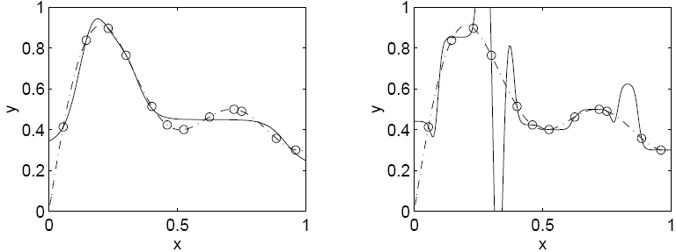
Number of hidden units
Function approximation example y=f(x)
A large number of hidden units leads to a small training error but not necessarily to a small test error
Adding hidden units always leads to a reduction of the training error
However, adding hidden units will first lead to a reduction of test error but then to an increase of test error ... (peaking effect, early stopping can be applied)
5 hidden units 20 hidden units

Slide 48
Size effect summary
Number of training samples Number of hidden units
Error
rate
Error
rate
Optimal number of
hidden neurons
Test set
Test set
Training set
Training set
Number of training samples Number of hidden units

Slide 49
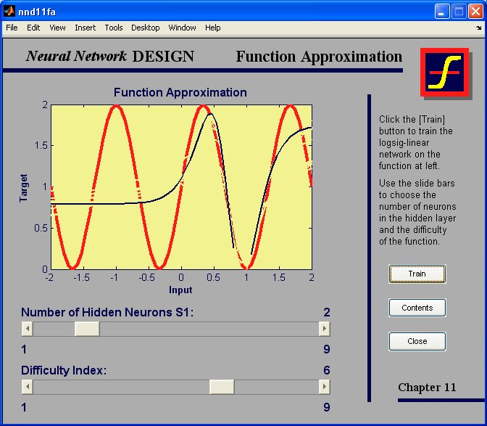

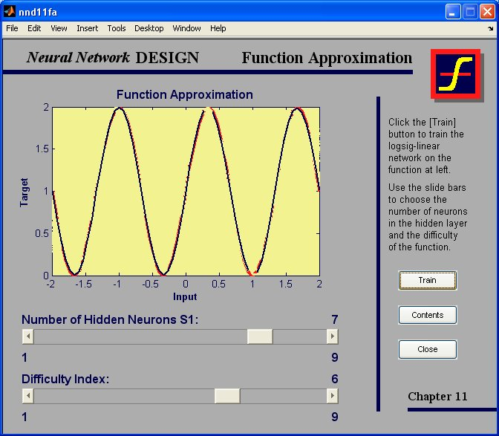
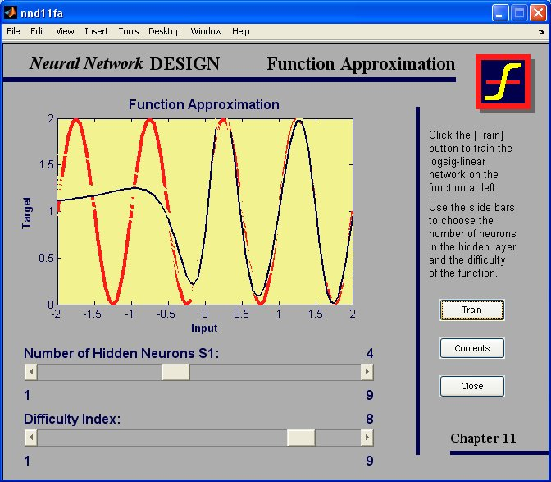

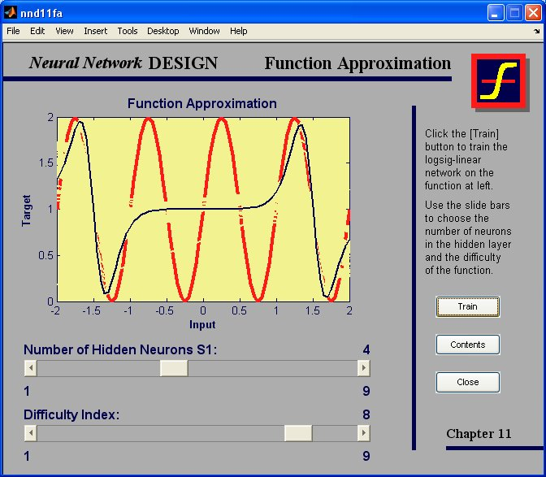
MATLAB demo
Run built-in command in MATLAB:
>> nnd11fa % Function approximation, variable number of hidden units

Slide 50
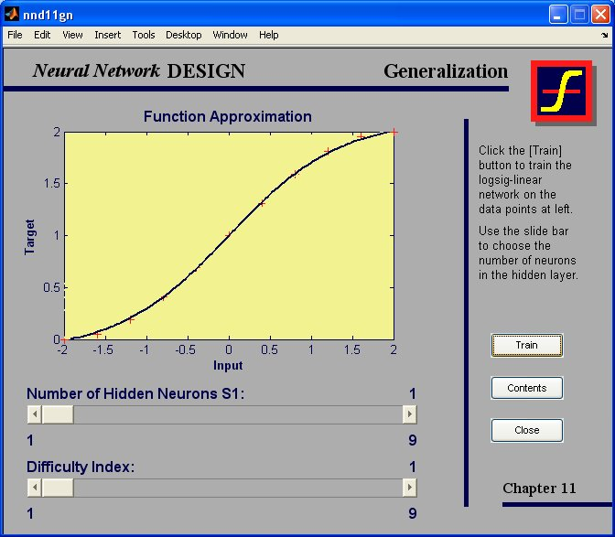

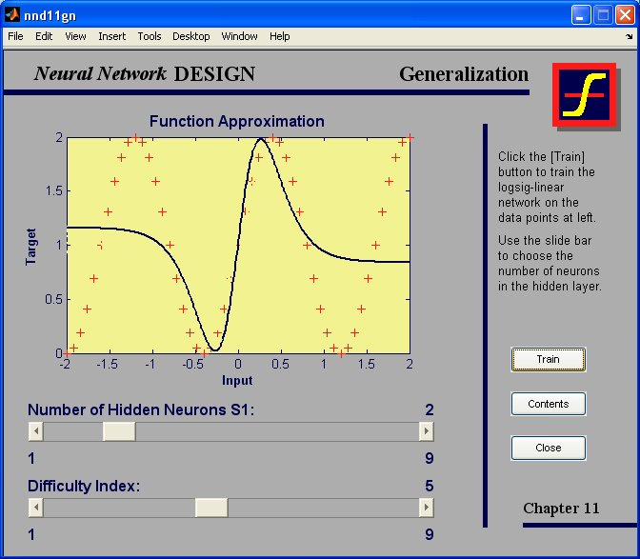
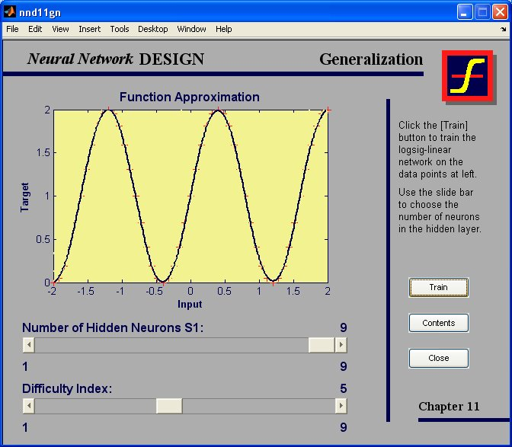
MATLAB demo
Run built-in command in MATLAB:
>> nnd11gn % Generalization, variable number of hidden units

Slide 51
4.6 MATLAB Live Script examples
NN4b_Multilayer_perceptron_XOR.mlx
Define a neural network for solving the XOR problem.
NN4c_Multilayer_perceptron_4classes.mlx
Define a neural network for classification in the 2-dimensional space into one of the 4 classes.
NN4d_Industrial_diagnostics.mlx
The task is to detect crack and overload defects from the measurement of the imprinting force during the industrial production of compressors.
NN4e_Industrial_diagnostics_pca.mlx
This example additionally introduces Principal Components Analysis (PCA) to transform the input space into low-dimensional feature space.

